Slide 1
Digital Synesthesia
PhD proposal

Slide 2
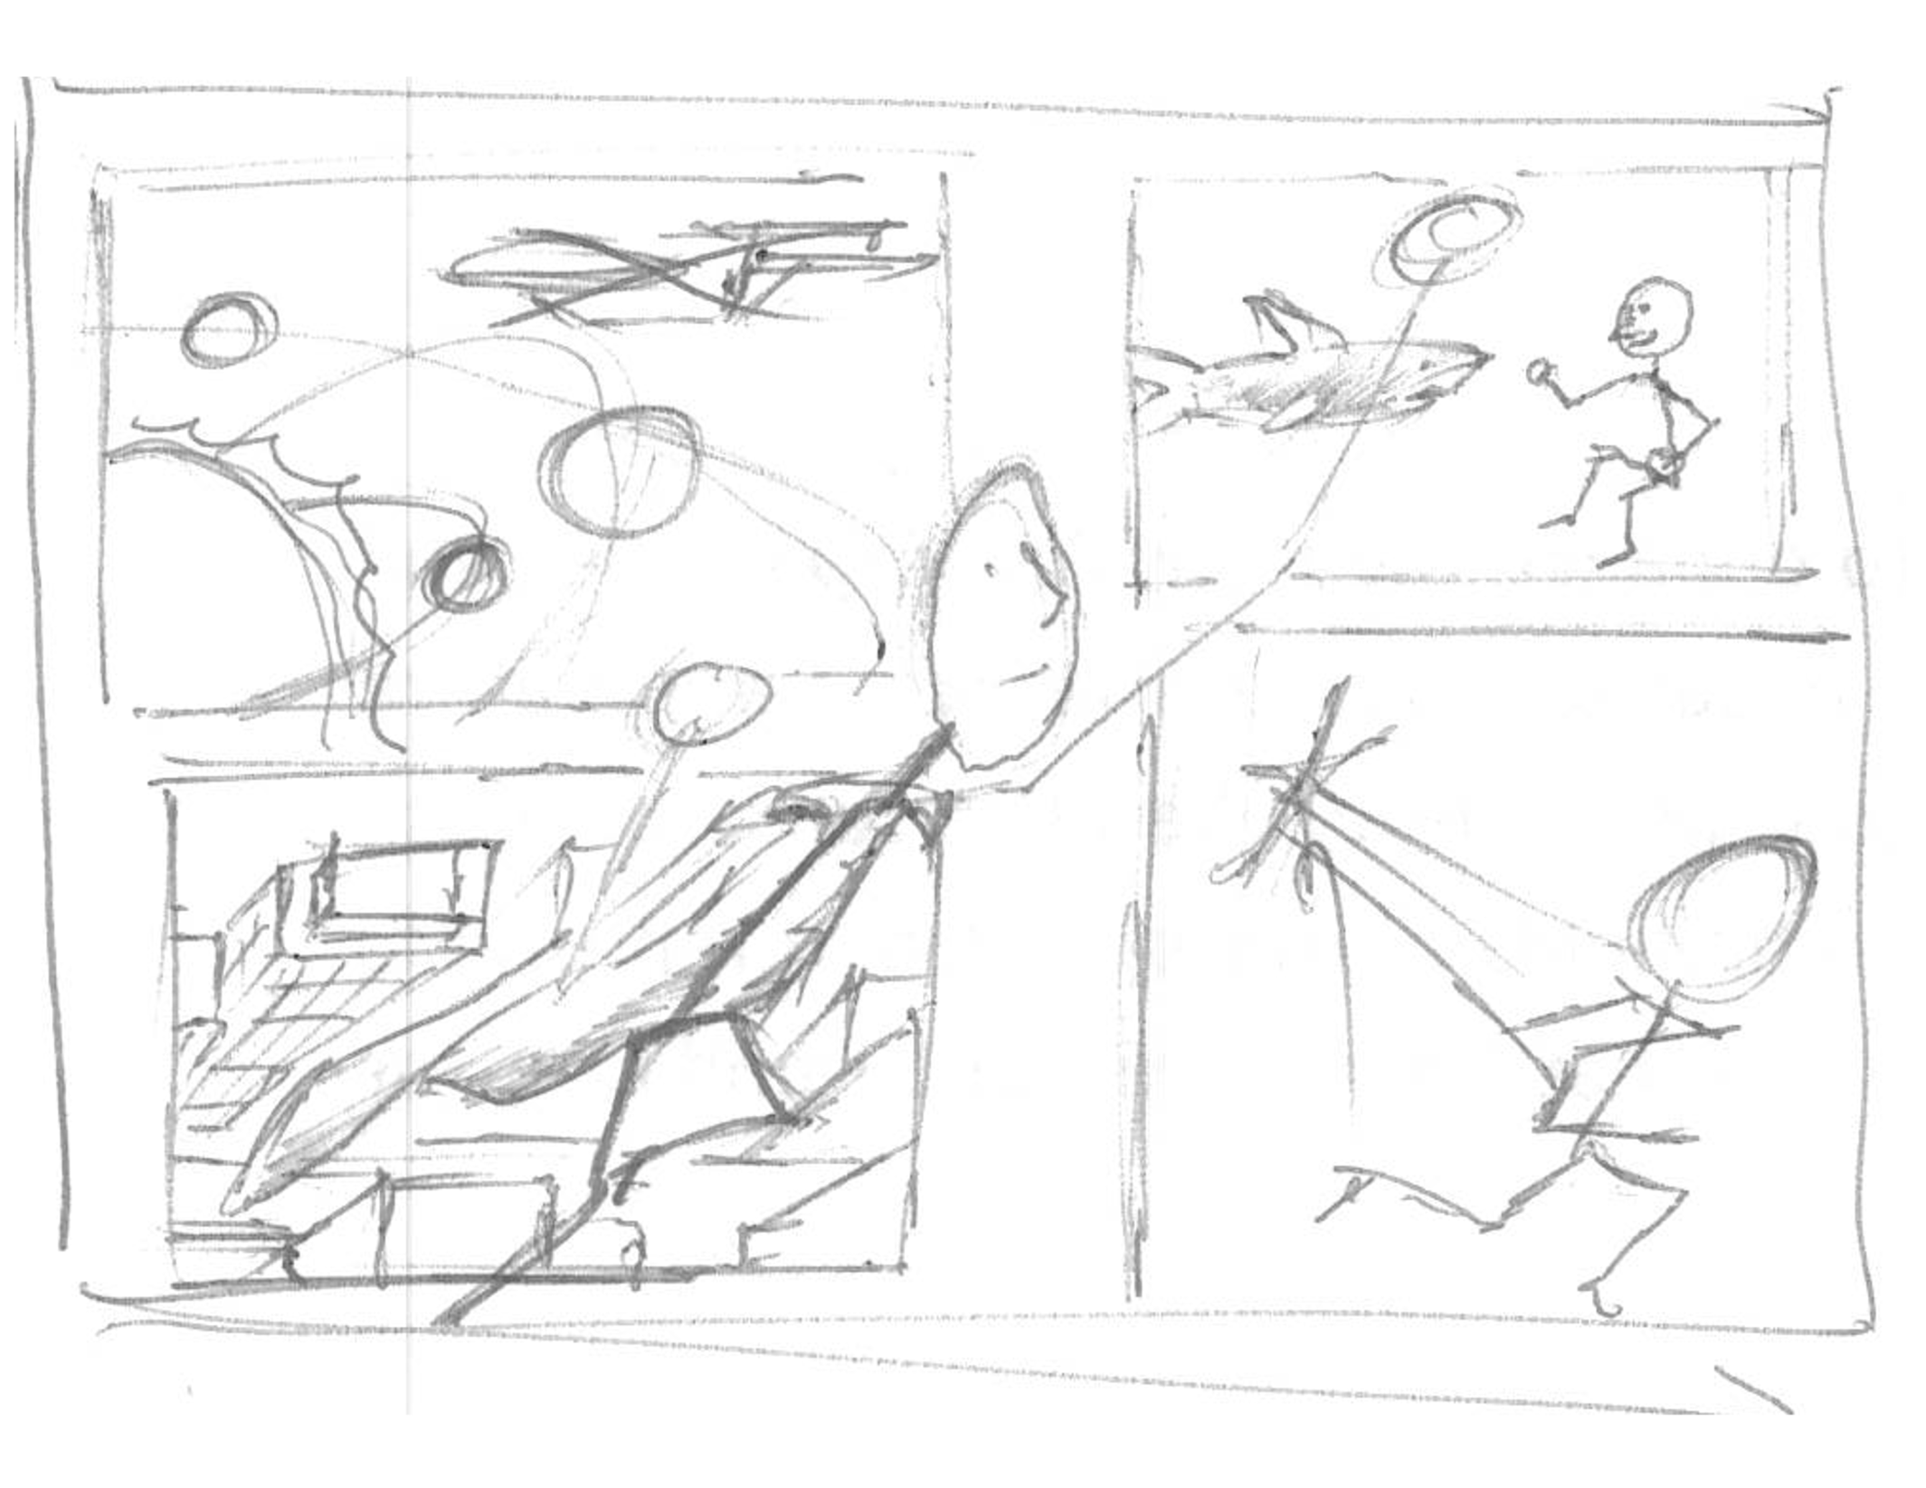
Intro
Dreams beyond natural capabilities

Slide 3
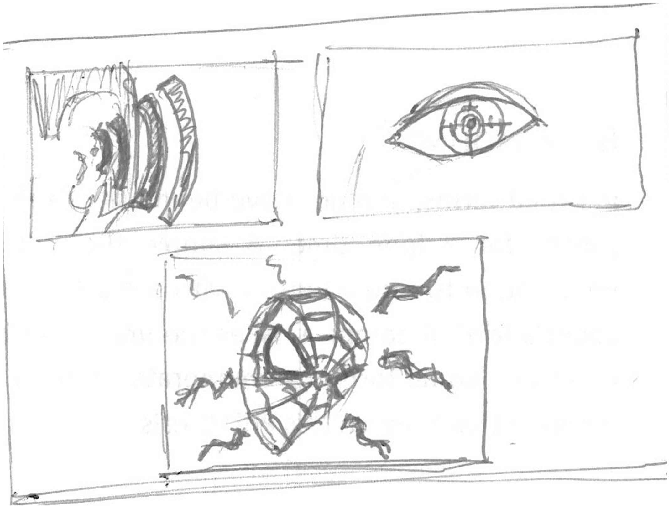
Intro
Super Heroes

Slide 4
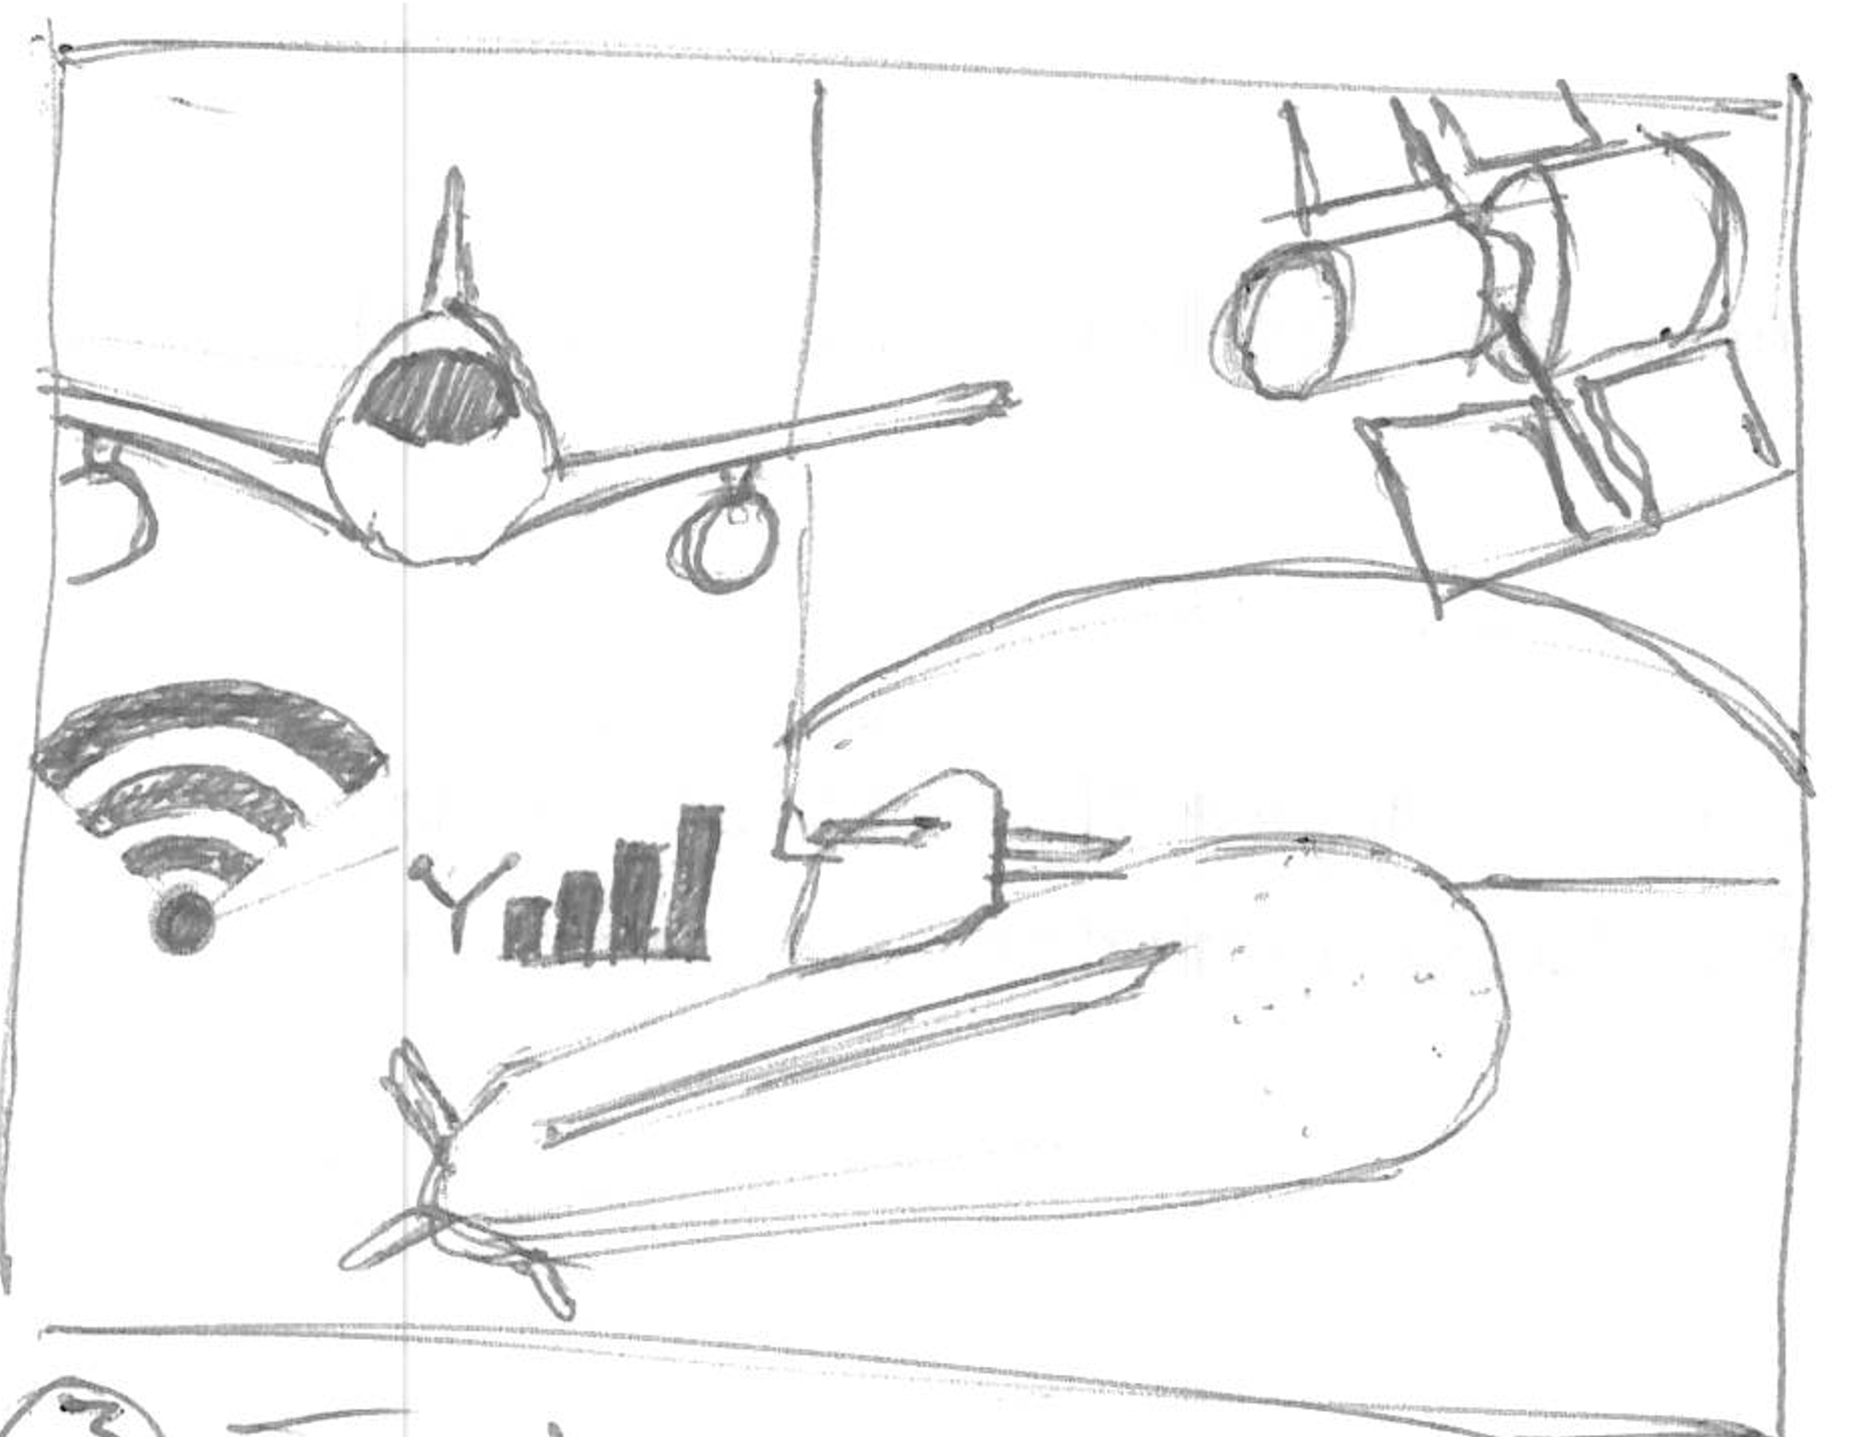
Intro
How technology made them com true

Slide 5
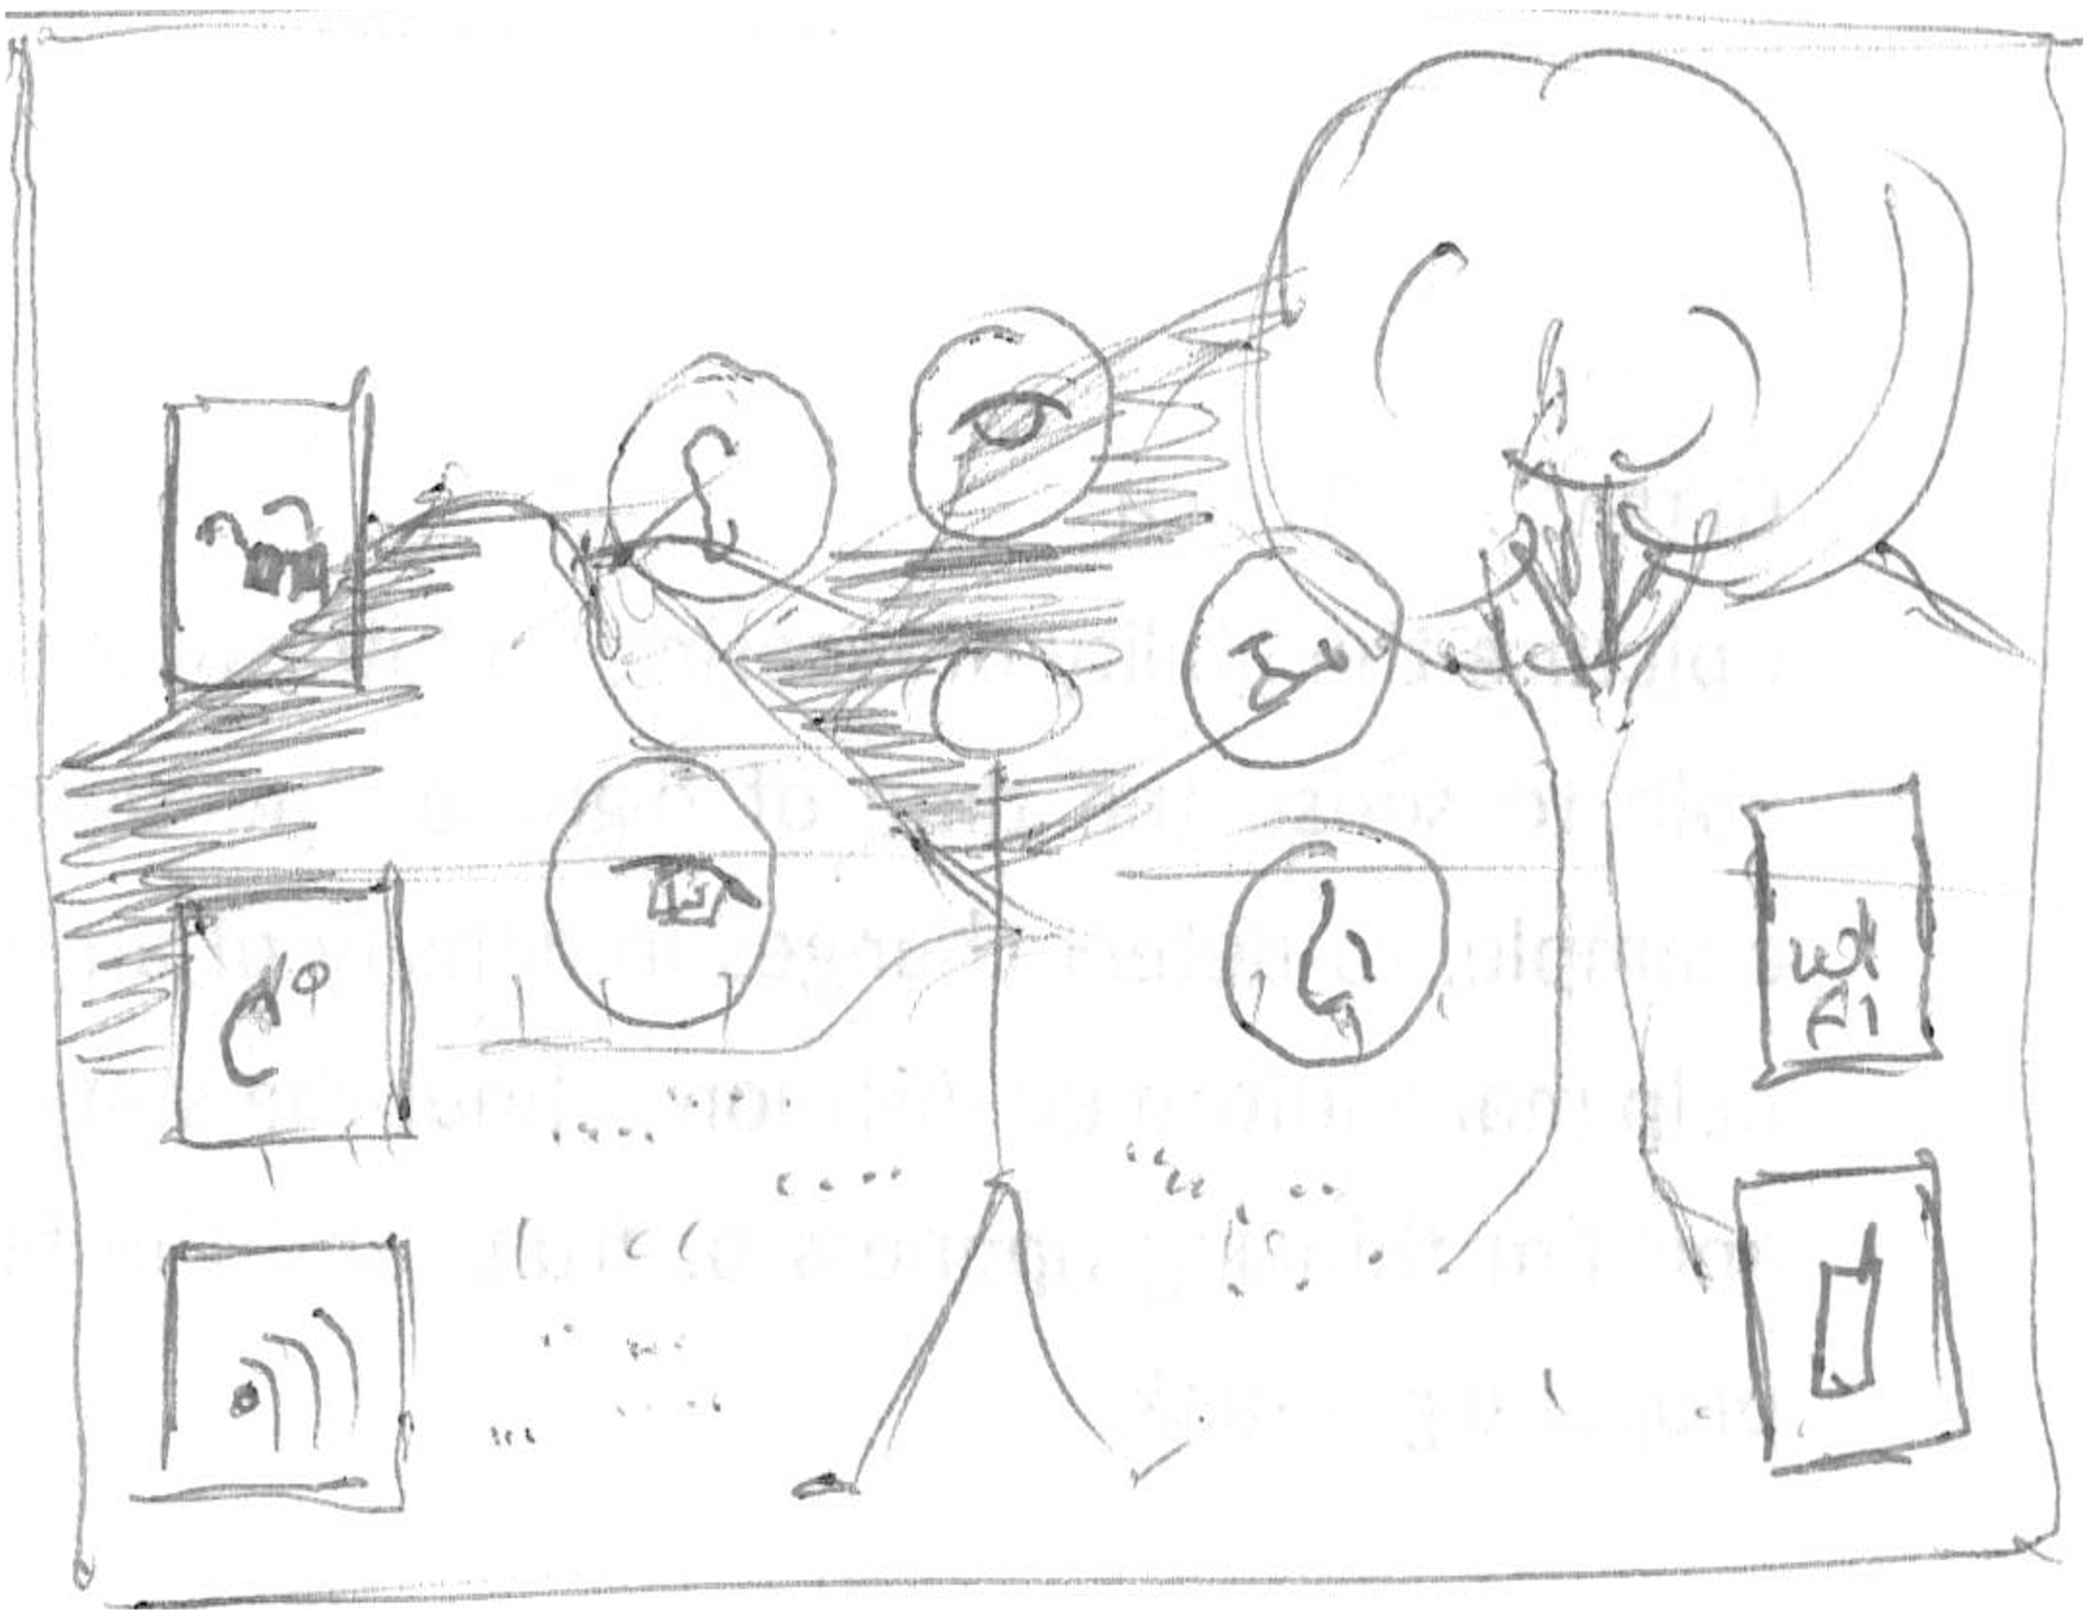
Intro - what
More info than can be sensed, in the world

Slide 6
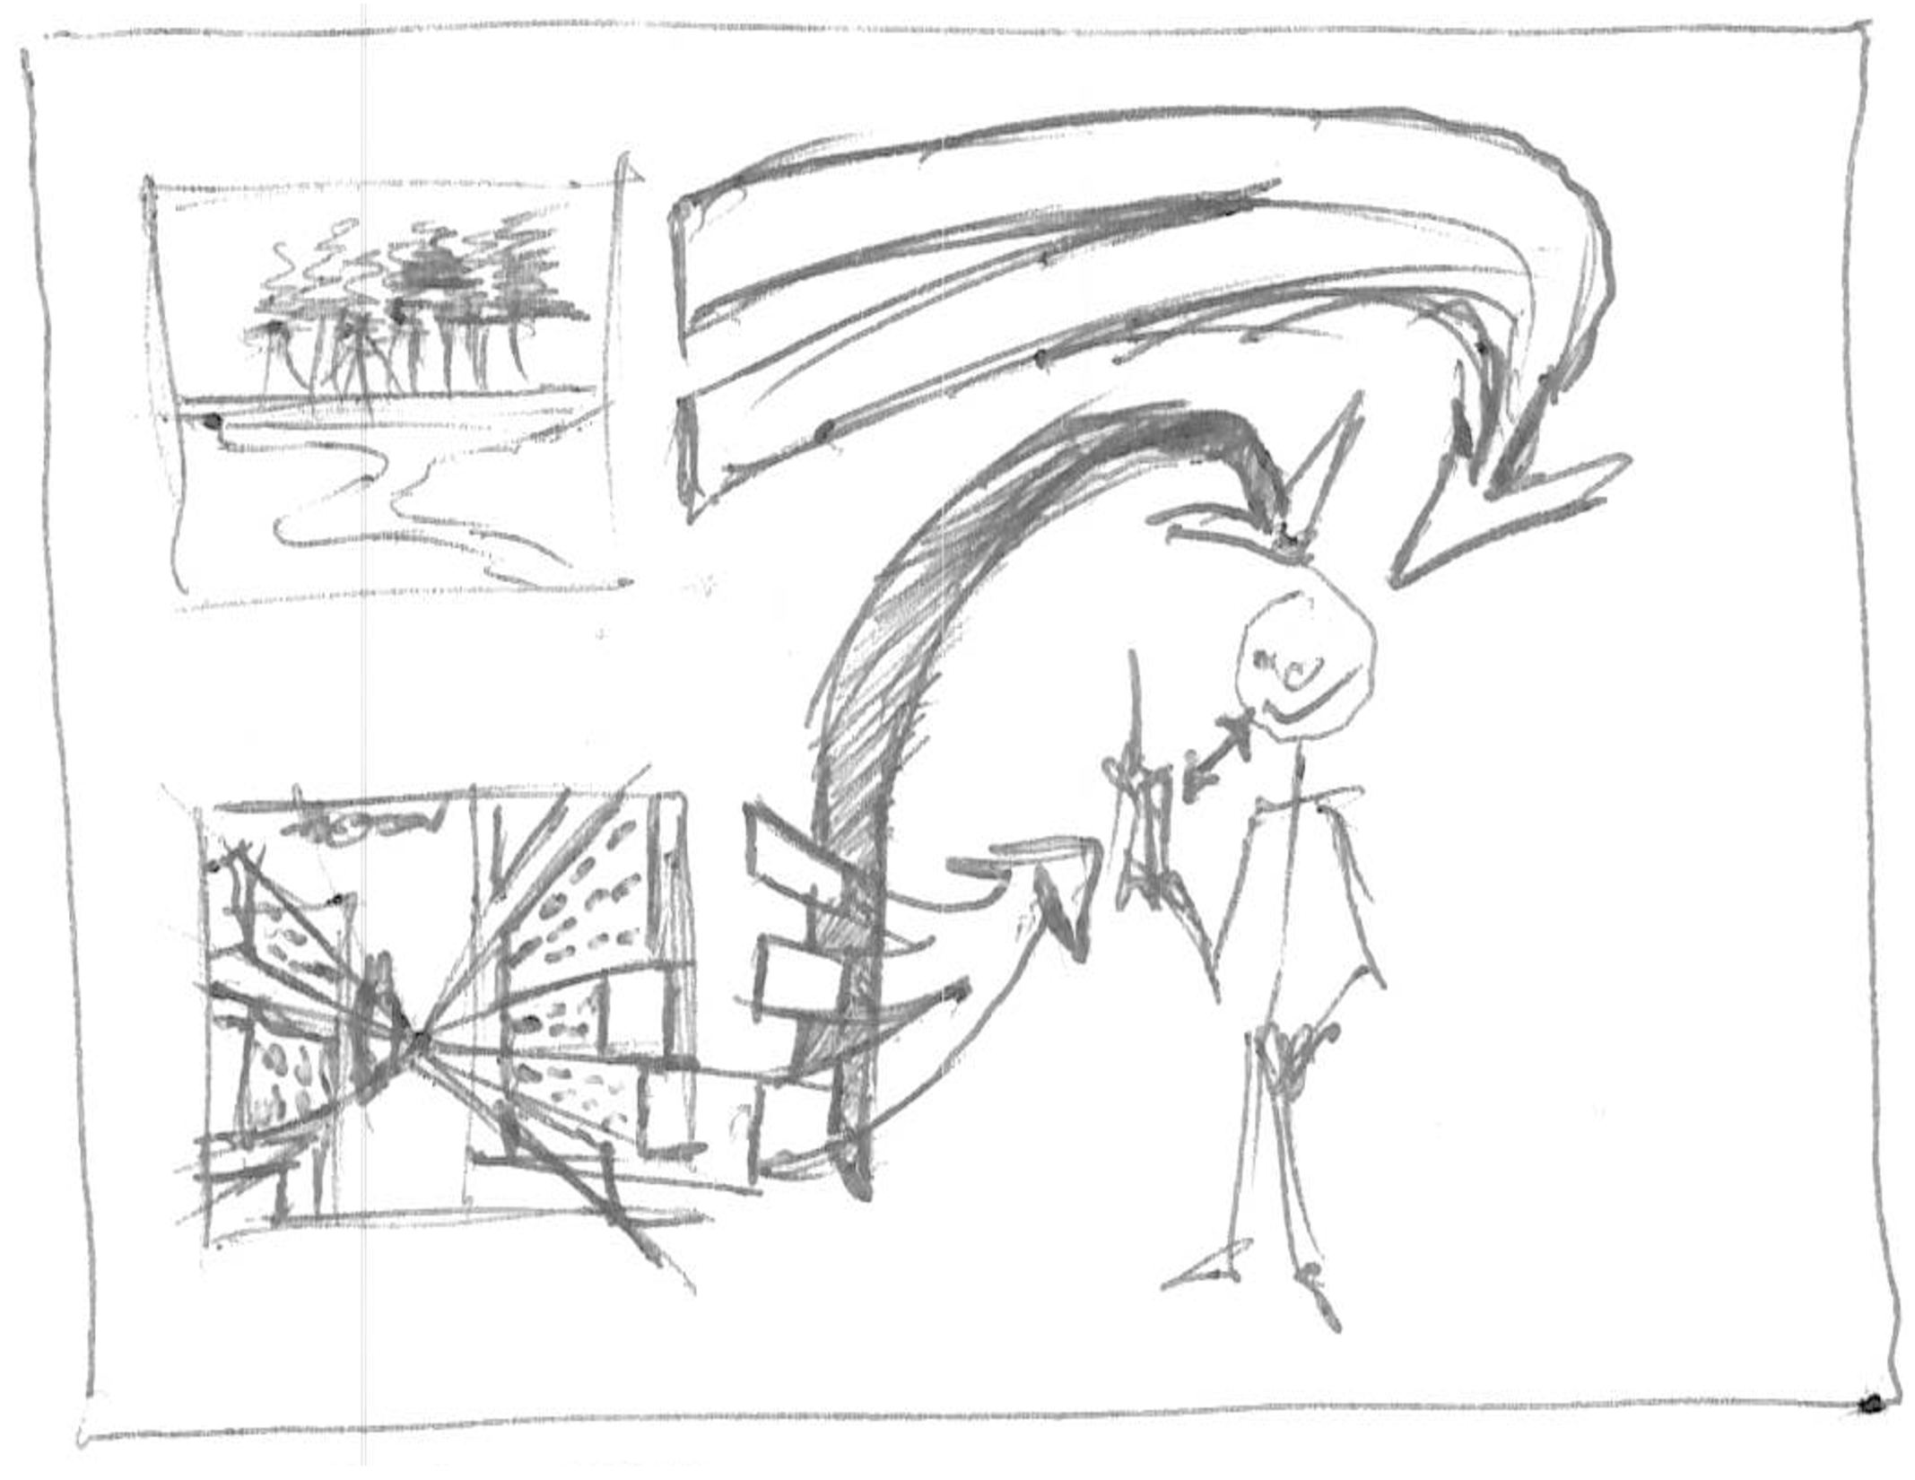
Intro - what
Mobile device a translator

Slide 7
Intro - why
Physical connection to the world by-pass device and cognition.

Slide 8
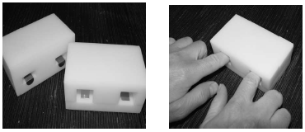
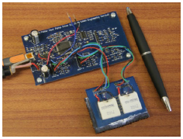
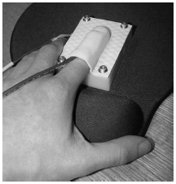
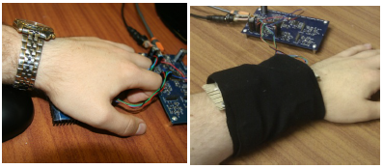
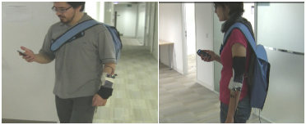
Background - INterface
Thermal

Slide 9
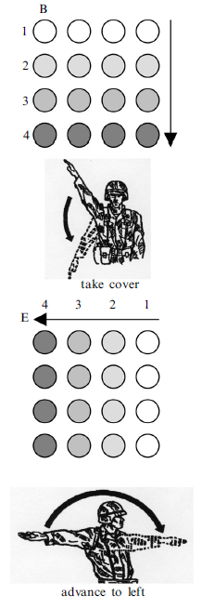
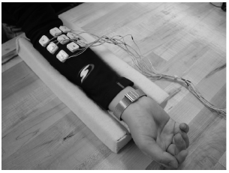
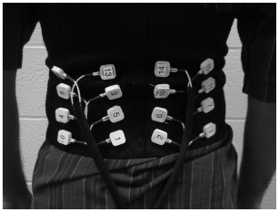
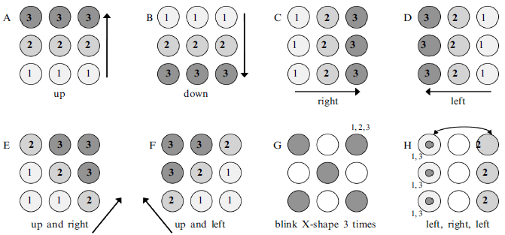
Background - INterface
Vibrotactile – Pattern Recognition

Slide 10
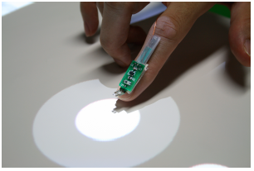
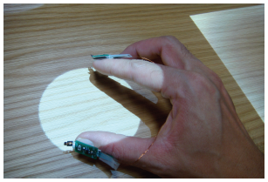
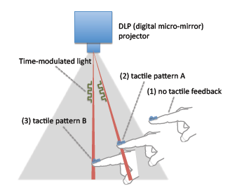
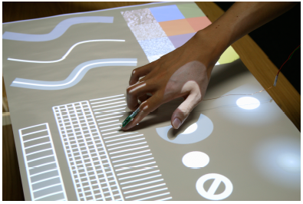
Background - INterface
Vibrotactile – Senseable Rays

Slide 11
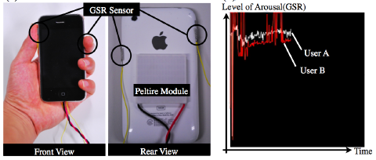
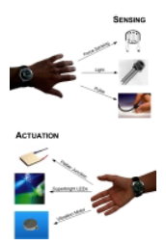
Background - INterface
pressages
Mobile communications

Slide 12
Background - INterface
Situational awareness

Slide 13
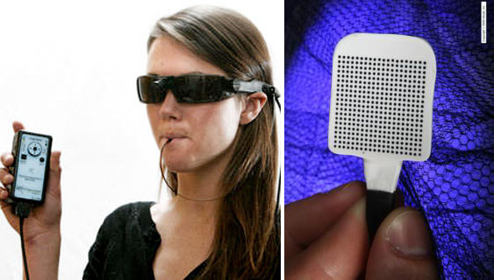
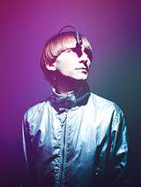
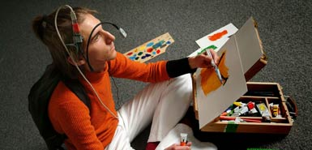
Background – senses
Sensory substitution

Slide 14
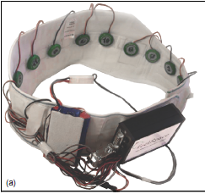
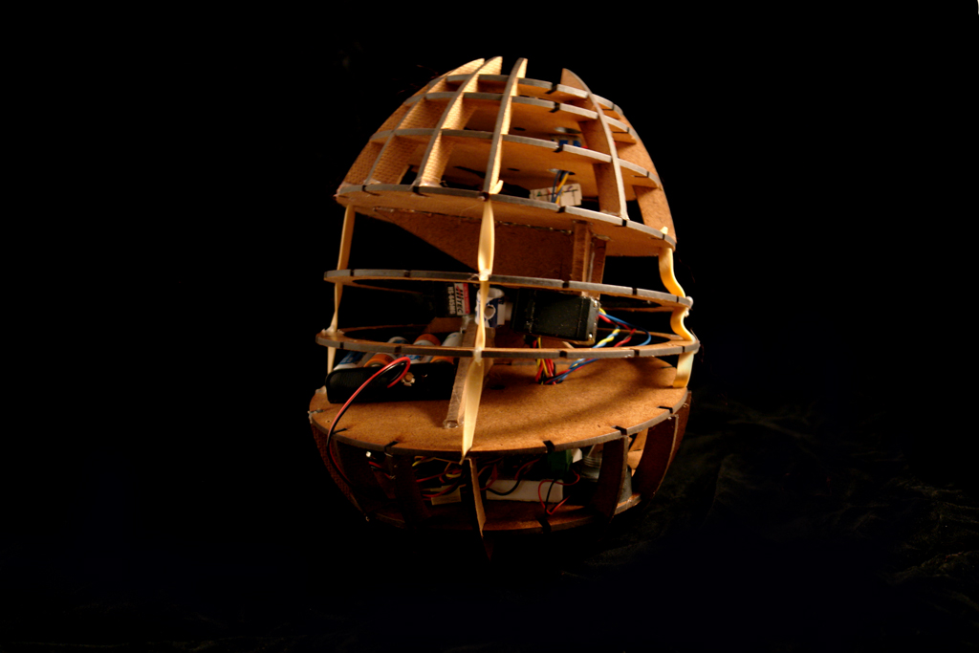
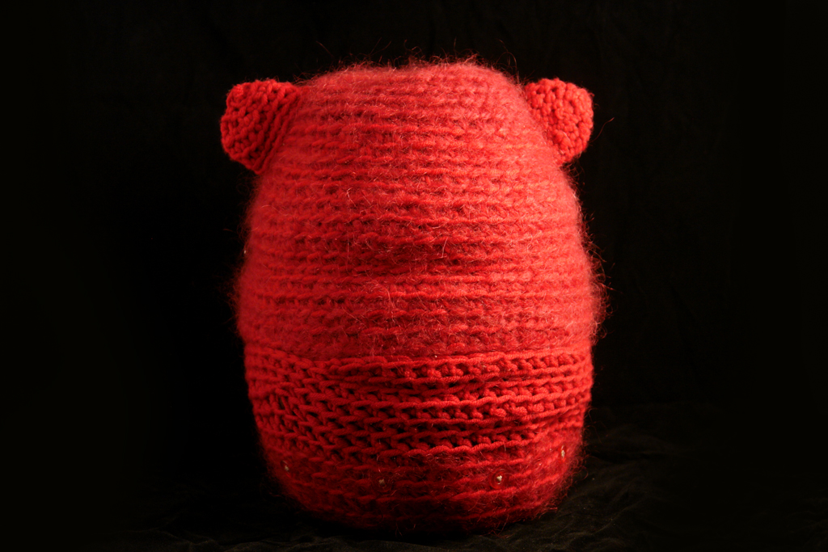
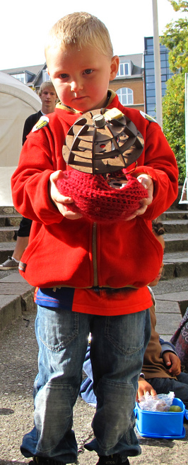
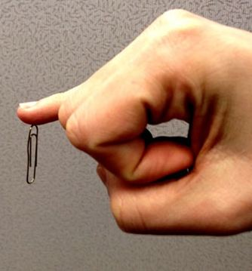
Background – senses
New Senses

Slide 15
Background
Neuroplasticity

Slide 16
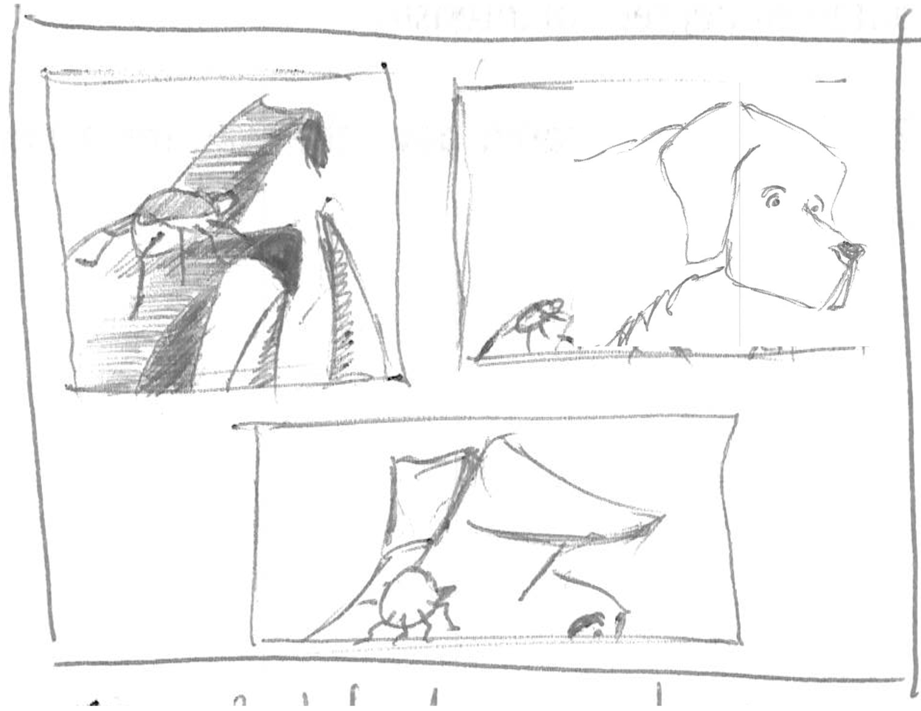
Digital Synesthesia
Uexkull

Slide 17
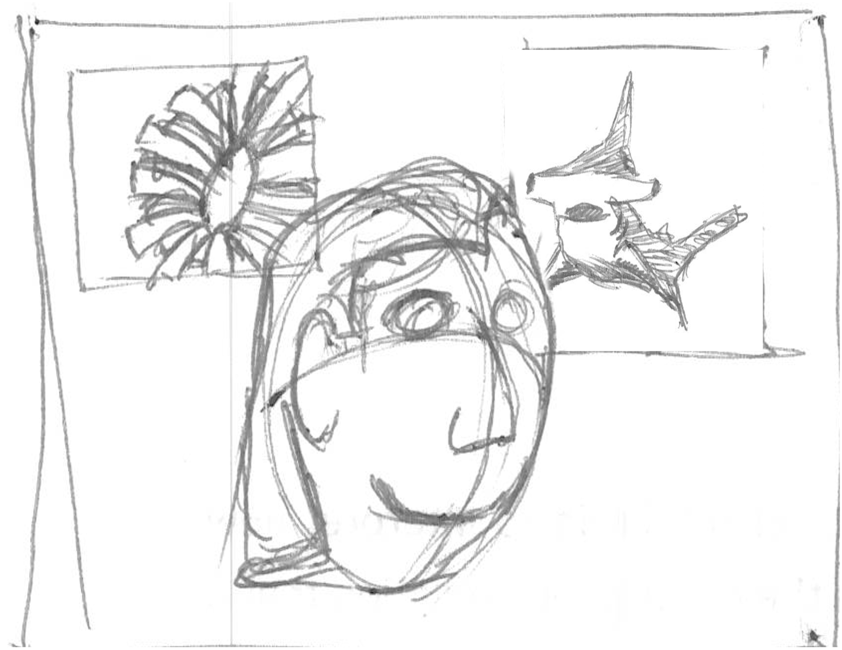
Digital Synesthesia
Nth sense

Slide 18
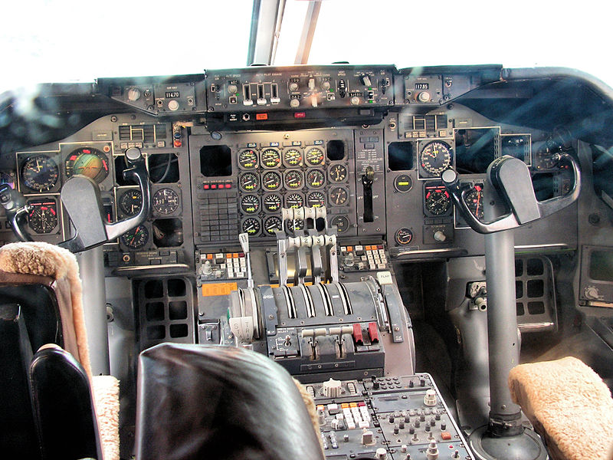
Digital Synesthesia
Cognitive Load

Slide 19
Digital Synesthesia
Personal interpretation

Slide 20
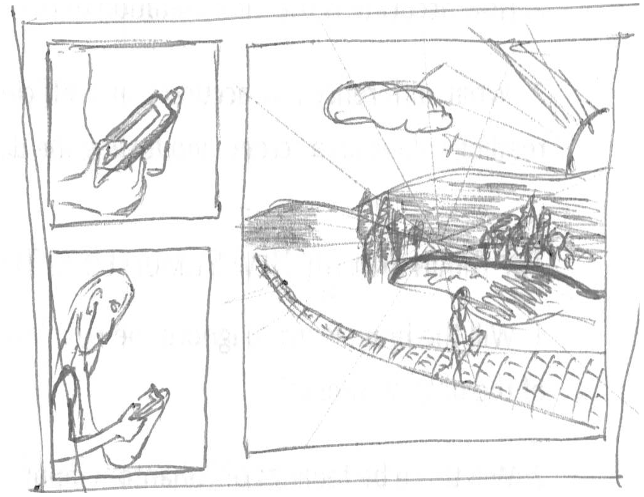
Digital Synesthesia
Immersion in the world

Slide 21
Research Questions
Discreet and Continuous Data

Slide 22
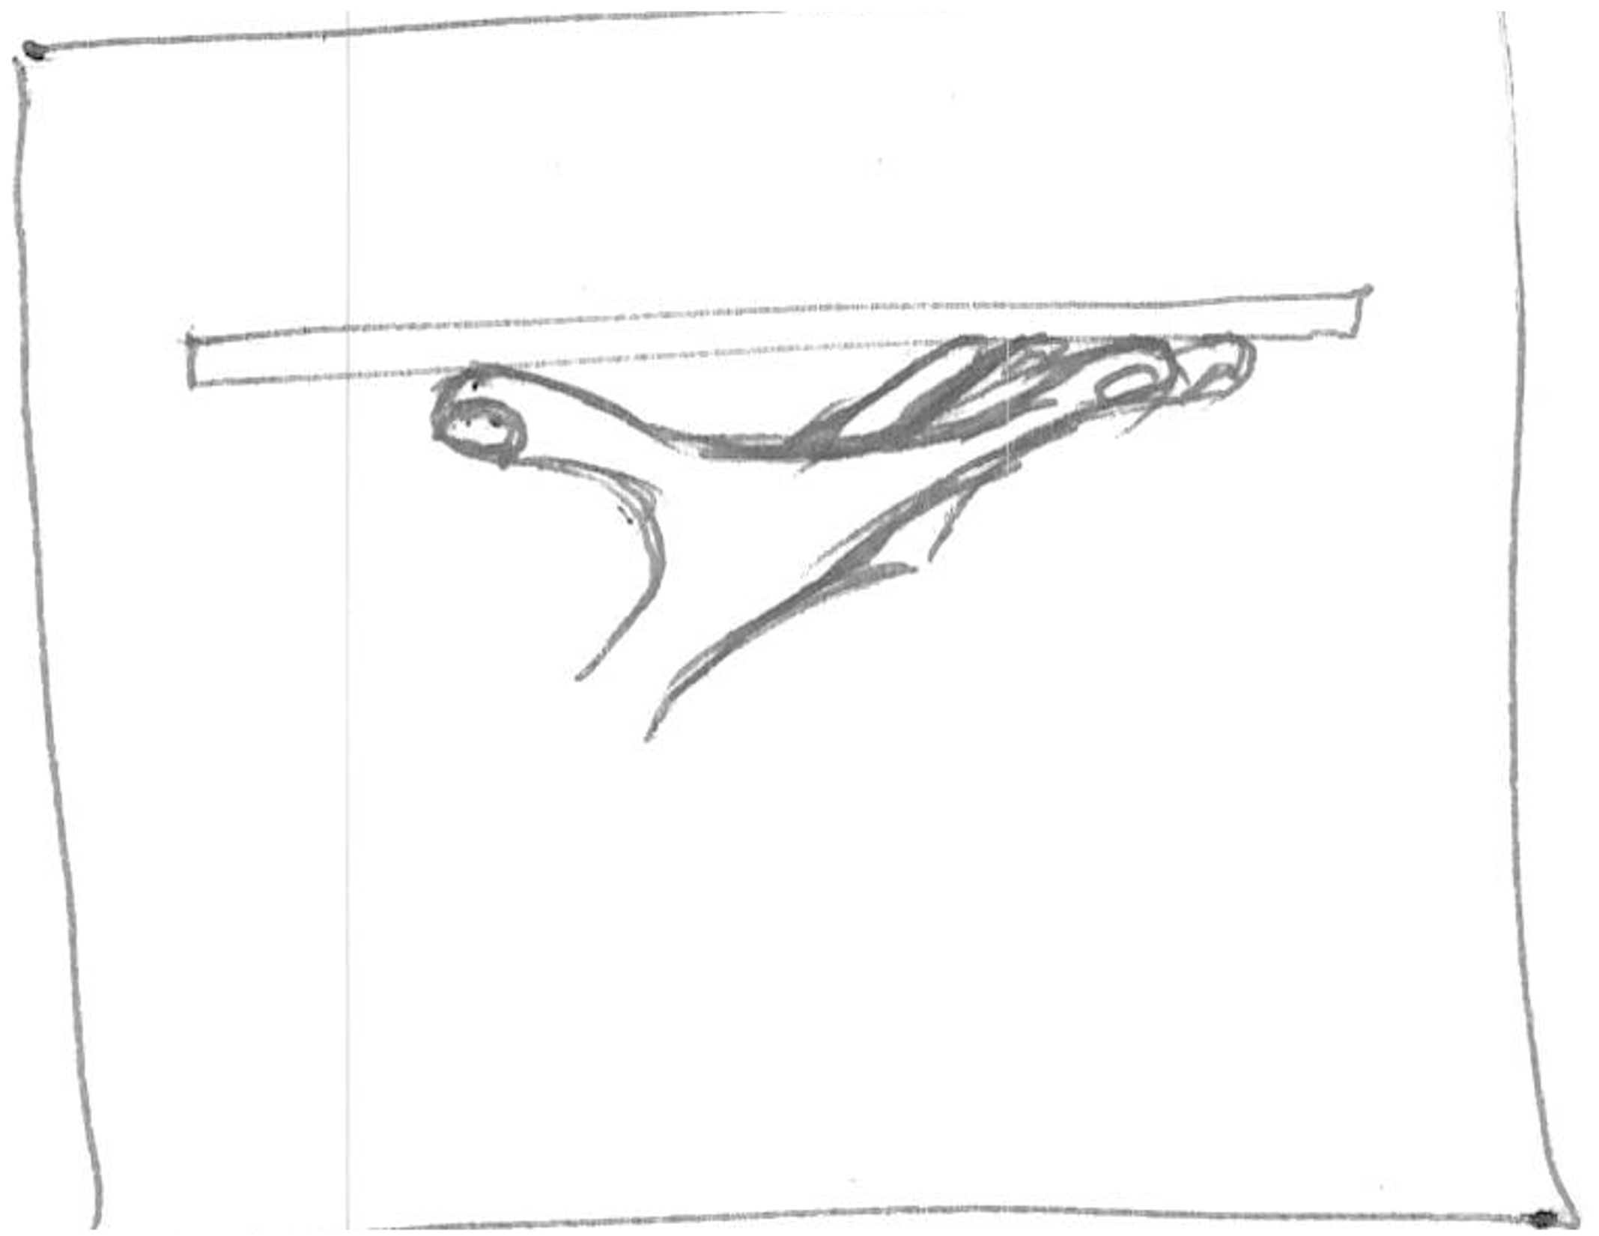
Research Questions
Sensory Augmentation

Slide 23
Research Questions
Sensory Substitution

Slide 24
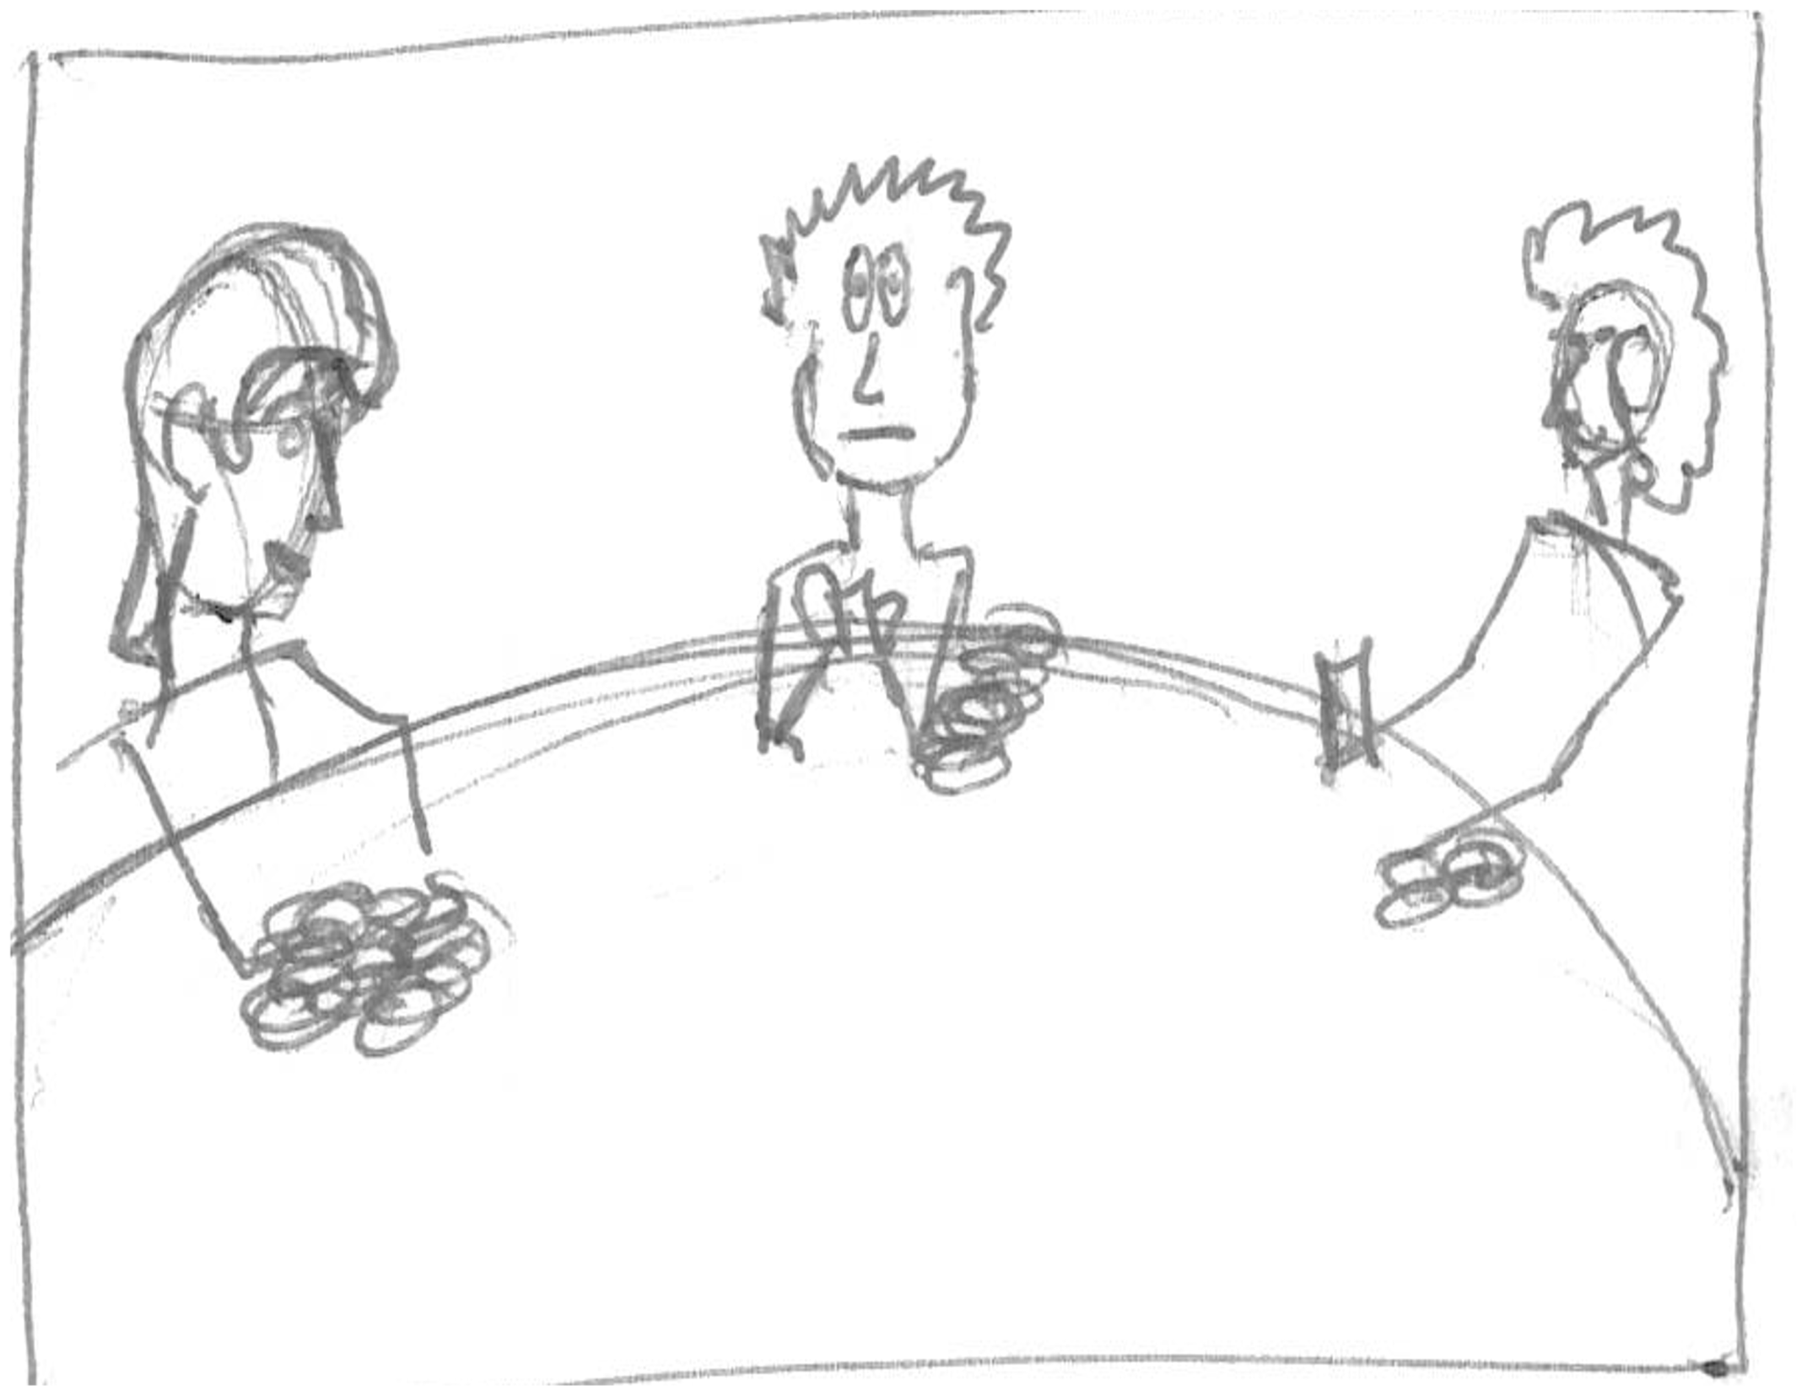
Research Questions
New Senses

Slide 25
Research Questions
New Stimuli

Slide 26
Research Questions
Escaping Visual

Slide 27
Research Questions
Design thinking

Slide 28
Research Questions
Human Development

Slide 29
Research PLan
Stage 1

Slide 30
Research plan
Stage 2

Slide 31
Research Plan
Stage 3

Slide 32
Research Plan
Stage 4

Slide 33
Timeline

Slide 34
Conclusion

Slide 35
Thankyou
Questions.

